Slide 1
IST 402
Ryan Bogniak, Josh Iovine, Nick Carradorini

Slide 2
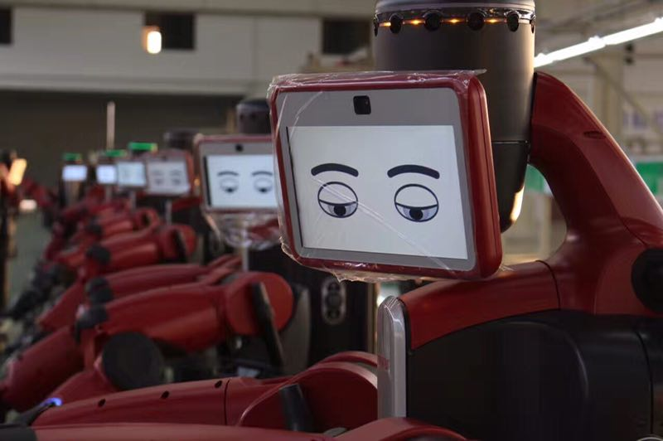
“The Origins of Artificial Intelligence”
The term, “Artificial Intelligence,” was first mentioned in a proposal that was written in 1956
Original ideators of AI set the precedent for how ML would function with detailed sketches
In the early days of AI there were very few ways to connect sensors to digital computers or to let those computers control actuators in the world.

Slide 3
“The Origins of Artificial Intelligence”
Takeaways
The main focus for now is to make systems as functional as possible and ensure the system’s recognition functions properly for the time being.
The origin of AI began with an abstract idea that slowly turned moved into the design and development stages following decades of research.
Although AI technologies are rapidly being improved and developed, processing speeds and compatibility issues can be further improved.

Slide 4

“The Seven Deadly Sins of Predicting the Future of AI”
This article speaks about the dangers that we could face by making extremely large speculations regarding AI.
“Mistaken predictions lead to fear of things that are not going to happen.”
The seven sins of predicting the future of AI starts off with the first sin being “over and underestimating”. This is the idea that we overestimate the effect of technology in the short run and underestimate the effect in the long run.

Slide 5
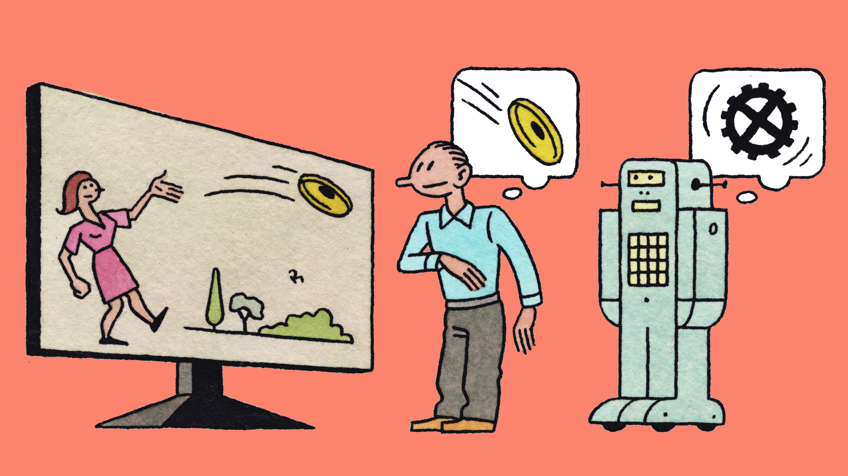
“The Seven Deadly Sins of Predicting the Future of AI” cont.
The second sin is “imagining magic” and this has to do with people imagining technology that we do not even know is capable yet, and therefore equal to magic. The author wants to draw people away from relying on a faith-based argument and not a scientific one.
The third sin is “performance versus competence” and this involves individuals making generalizations about AI and comparing their task performance to the competence of a person. These two differ from each other in so many ways that it is best to stay away from making these generalizations.
The fourth sin is called “suitcase words” and these words are applied to machines but they have completely separate meanings when they are applied to humans.

Slide 6

“The Seven Deadly Sins of Predicting the Future of AI” cont.
The fifth sin is titled “exponentials” and it speaks about the idea that not all exponentials are real so when they are used in an argument they can not always be taken seriously.
The sixth sin is “hollywood scenarios” and the author describes these to be when people spend time worrying about shock scenarios in the future. This is not helpful because the instances do not happen as often as you would expect and they typically do not have a connection to what happens in the future.
The seventh and final sin “speed of deployment” has to do with people assuming that once a new technology is announced that it will be ready for deployment soon. The development of this technology, and the importance to perfect it makes this development process run longer than anticipated.

Slide 7

Advancements in ML through games
The idea for ML started with Alan Turing and Donald Michie when they were sitting playing checkers and were trying to figure out a way for a computer to play checkers on its own.
ML has advanced a great amount in recent history and a big factor to that is that games have become more and more complicated causing people to figure out how to make machines answer more complicated problems and predict more.

Slide 8

Matchboxes and the future
MENACE was described in a paper written 1963 explaining how Donald Michie started playing against and operating the machine in order to play tic-tac-toe against a computer.
Eventually the machine got better and better and soon began to win.
The process which was being completed is still used today just on a much larger scale with more variables but it is based on the same thing.

Slide 9
References
https://rodneybrooks.com/forai-the-origins-of-artificial-intelligence/
https://rodneybrooks.com/the-seven-deadly-sins-of-predicting-the-future-of-ai/
https://rodneybrooks.com/forai-machine-learning-explained/

